Slide 1
Weekly report
Xiaoshu Luo

Slide 2
Optimization
Randomized search (Using hyperopt)
PSO (Using pyswarm)
Bayesian optimization (Using optuna)
Applying on neural network for 28-day cement strength

Slide 3
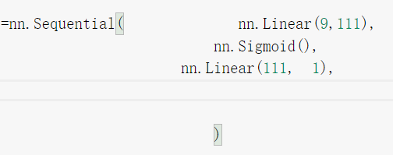
Random search PSO Bayesian Optimization
ANN 3 layer tuning parameters (neuron number, optimizer and learning rate)
 | Random | PSO | Bayesian
time | 50 min | > 3 hours | ≈50 min
Accuracy(R2) | 7255 | 0.7269 | 0.74
Params | {lr’: 0.0588, 'n_units_l0’: 111, 'optimizer': 'Adam’} | {lr': 0.0425, 'n_units_l0’: 150, 'optimizer': 'Adam’} | {lr': 0.0300, 'n_units_l0': 135, 'optimizer': 'Adam’}

Slide 4
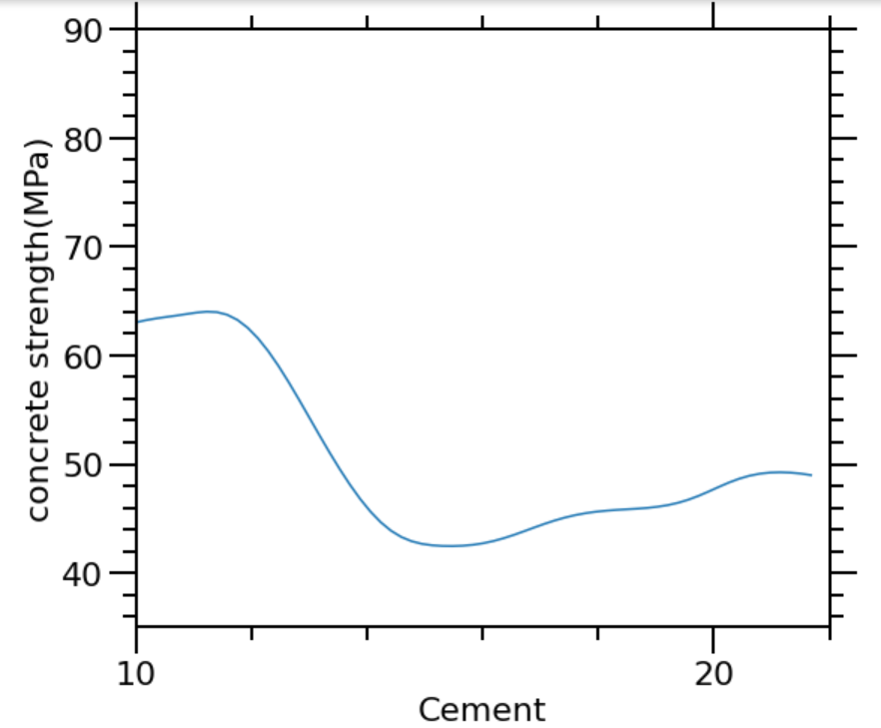
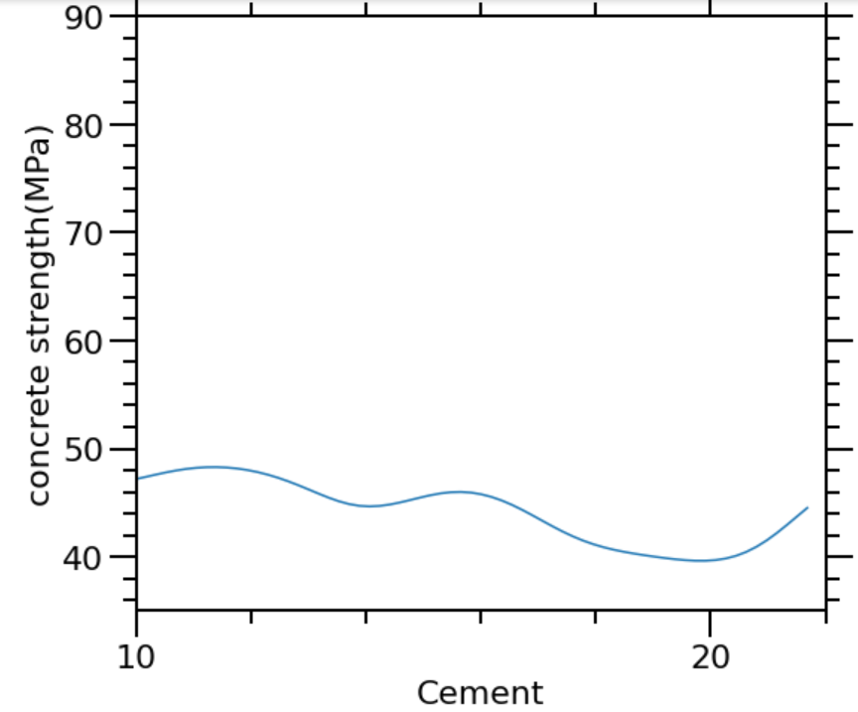
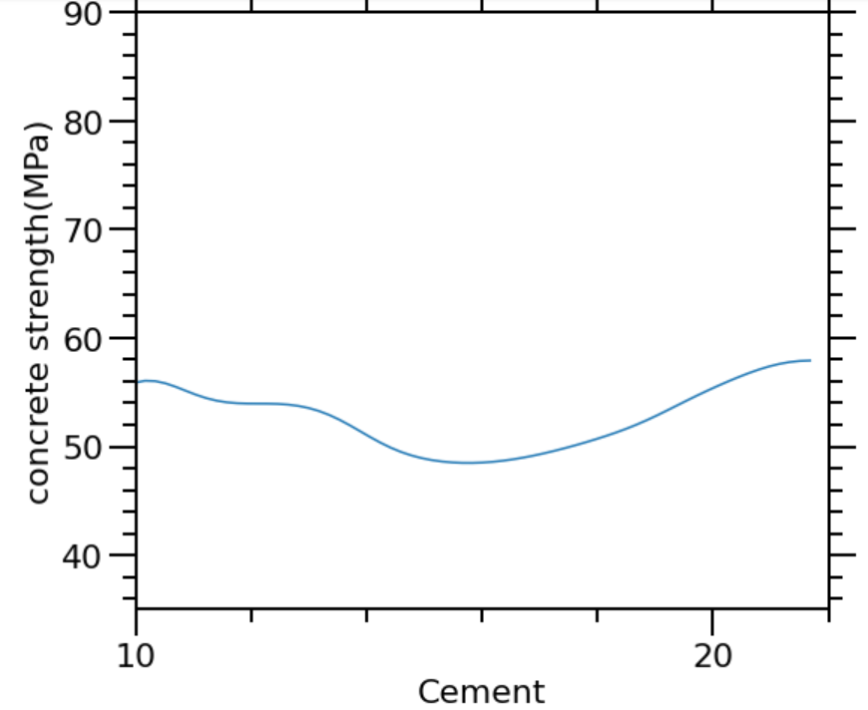
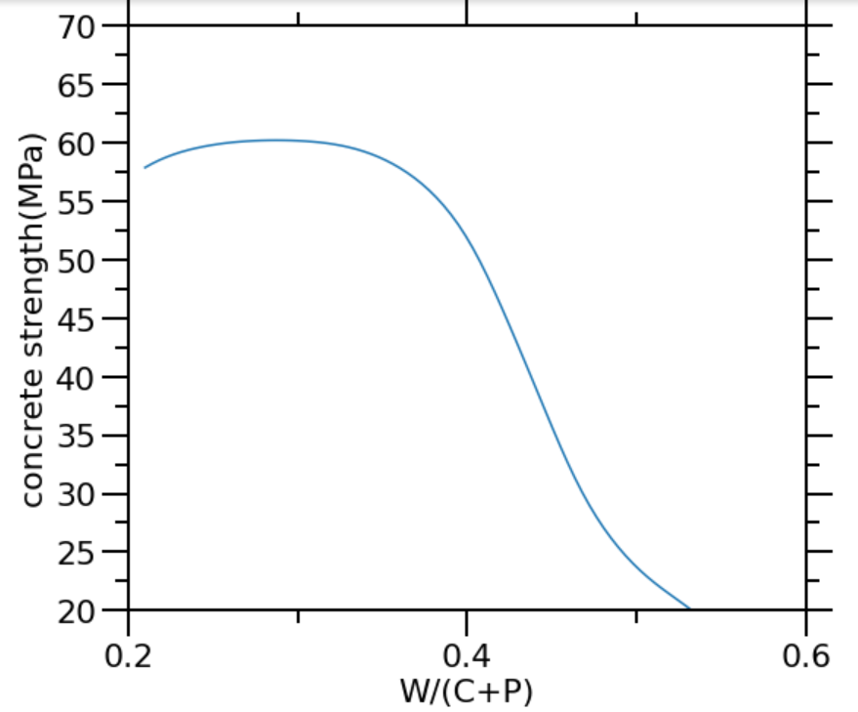
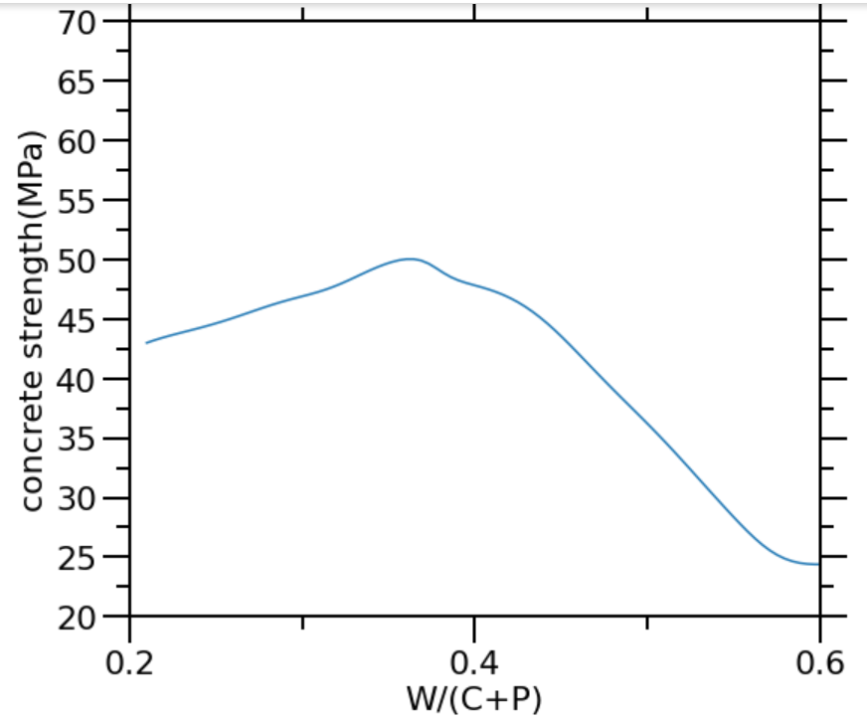
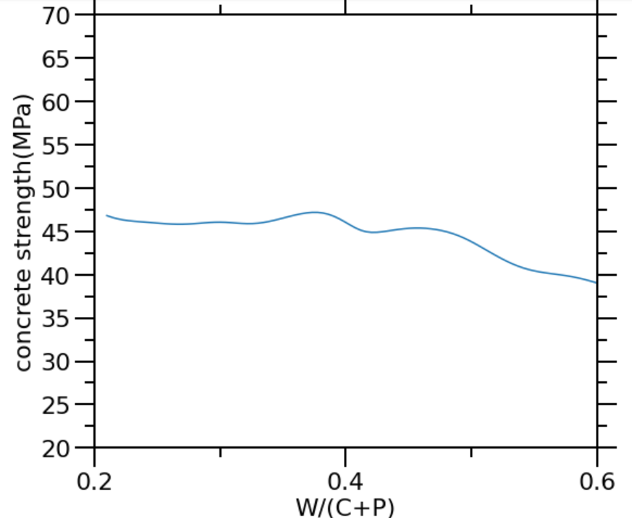
Random search PSO Bayesian Optimization

Slide 5
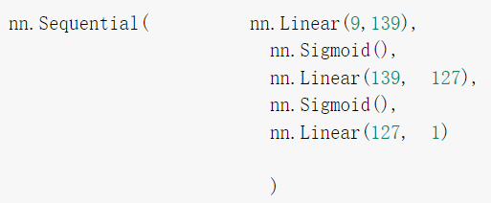
Random search PSO Bayesian Optimization
ANN 5 layer tuning parameters (neuron number, optimizer and learning rate)
 | Random | PSO | Bayesian(optuna)
time | 2.5hours | >4 hours | 3.5 hours
accuracy | 0.7263 | 0.7276 | 0.7479
Params | {lr’: 0.0571, 'n_units_l0’: 112, 'n_units_l1’: 125, 'optimizer': 'Adam’} | {lr’:0.0322, 'n_units_l0’:98, 'n_units_l1’:107 , 'optimizer': 'Adam’} | {'n_units_l0': 139, 'n_units_l1': 127, 'optimizer': 'Adam', 'lr': 0.0443}

Slide 6
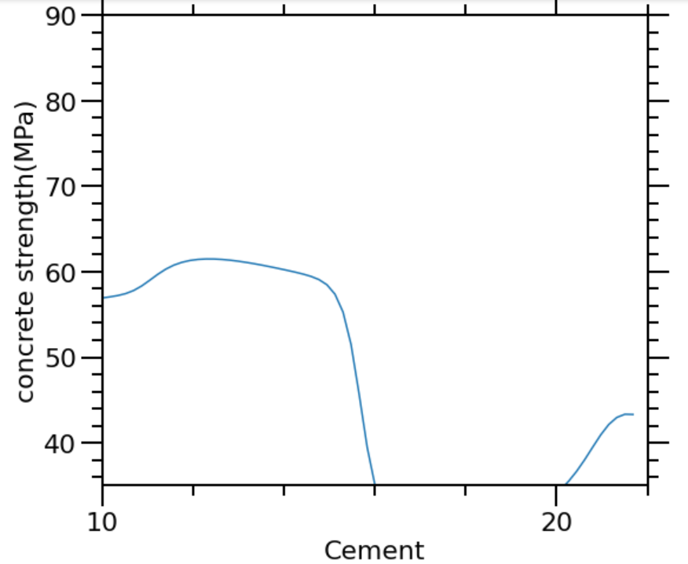
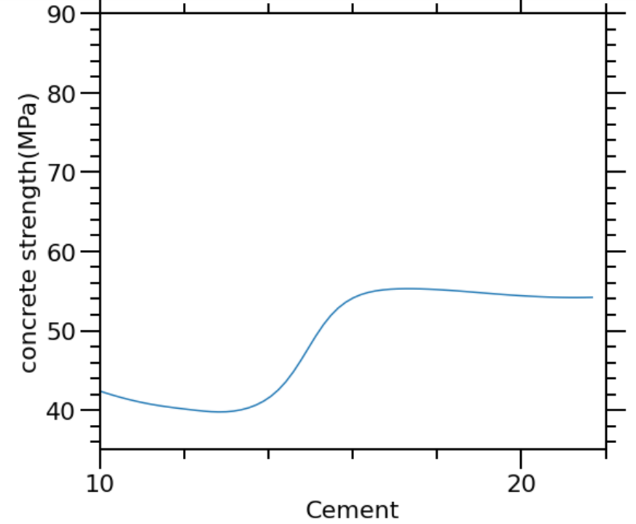
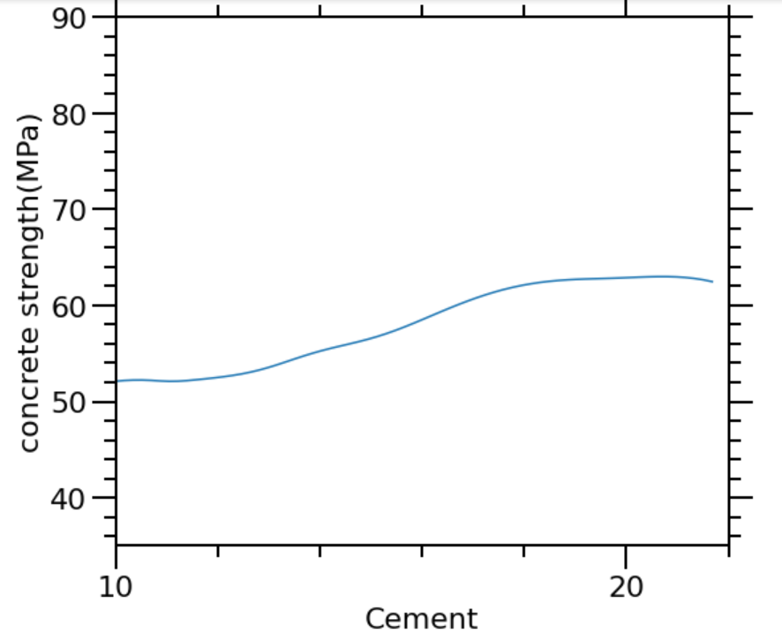
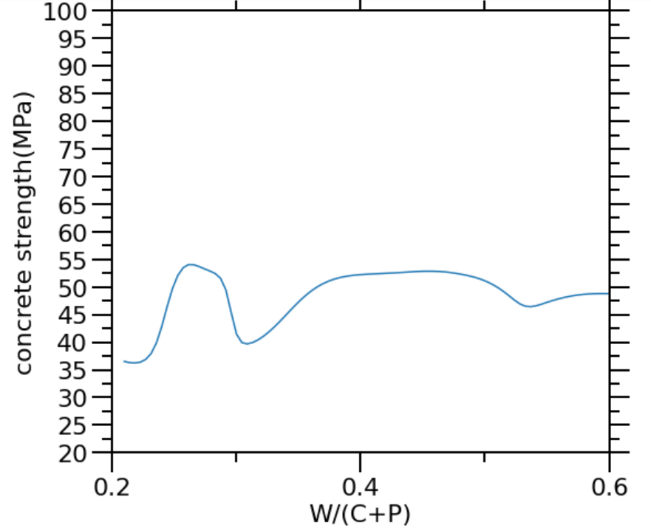
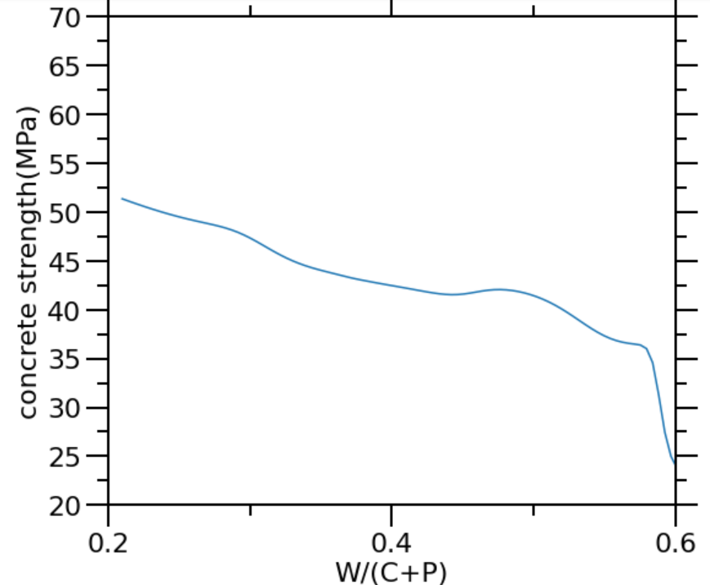
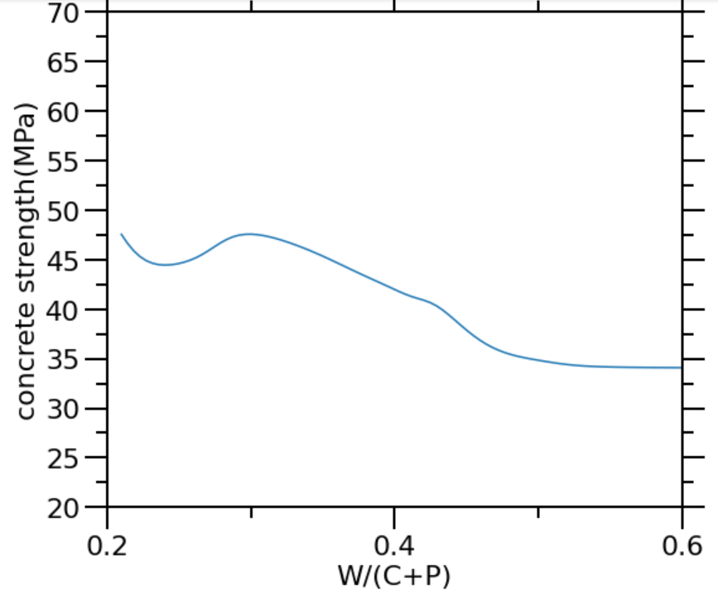
Random search PSO Bayesian Optimization

